Slide 1


Slide 2
Mixing Time Bounds for Quantum Gibbs Samplers
Akshar Ramkumar
Mentors: Prof. John Preskill, Dr. Mehdi Soleimanifar, Dr. Anthony Chen
August 21, 2024

Slide 3
Outline
“If you think you understand quantum mechanics, then you don’t.” - Richard Feynman

Slide 4
Outline
Introduction to Quantum Computing
“If you think you understand quantum mechanics, then you don’t.” - Richard Feynman

Slide 5
Outline
Introduction to Quantum Computing
Quantum Gibbs Sampling
“If you think you understand quantum mechanics, then you don’t.” - Richard Feynman

Slide 6
Outline
Introduction to Quantum Computing
Quantum Gibbs Sampling
Markov Chains
“If you think you understand quantum mechanics, then you don’t.” - Richard Feynman

Slide 7
Outline
Introduction to Quantum Computing
Quantum Gibbs Sampling
Markov Chains
Project and Results
“If you think you understand quantum mechanics, then you don’t.” - Richard Feynman

Slide 8
What is Quantum Computing?

Slide 9
What is Quantum Computing?
“Faster” algorithms are achievable through small-scale physics

Slide 10

What is Quantum Computing?
“Faster” algorithms are achievable through small-scale physics
“Bloch Sphere”

Slide 11
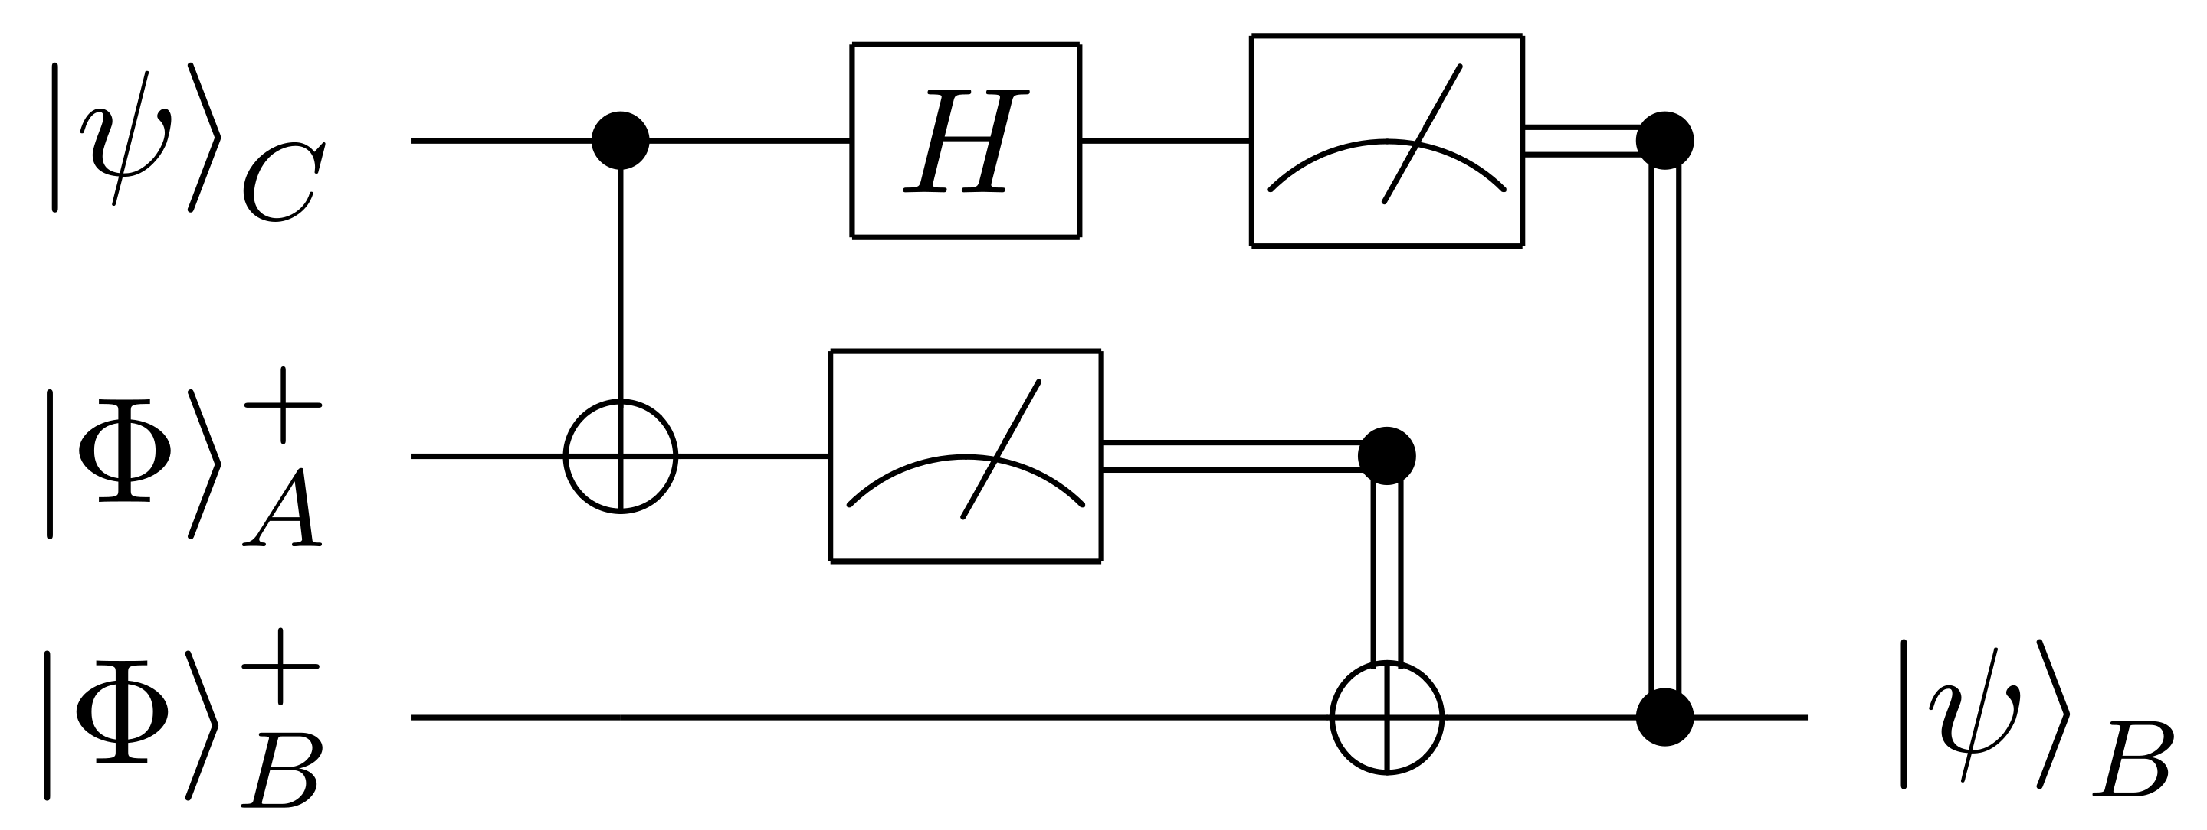
What is Quantum Computing?
“Faster” algorithms are achievable through small-scale physics
Input
“qubits”
Output “qubit”
Quantum Circuit

Slide 12
Quantum Gibbs Sampling
What can quantum computing do?

Slide 13
Quantum Gibbs Sampling
What can quantum computing do?
Simulate physical systems

Slide 14
Quantum Gibbs Sampling
What can quantum computing do?
Simulate physical systems ✔️

Slide 15
Quantum Gibbs Sampling
What can quantum computing do?
Simulate physical systems ✔️
Evaluate the “static” properties of a system

Slide 16
Quantum Gibbs Sampling
What can quantum computing do?
Simulate physical systems ✔️
Evaluate the “static” properties of a system
e.g. the minimum energy

Slide 17
Quantum Gibbs Sampling
What can quantum computing do?
Simulate physical systems ✔️
Evaluate the “static” properties of a system❓
e.g. the minimum energy

Slide 18
Quantum Gibbs Sampling
What can quantum computing do?
Simulate physical systems ✔️
Evaluate the “static” properties of a system❓
e.g. the minimum energy
Question: Can a quantum computer prepare the Gibbs state of a system?

Slide 19
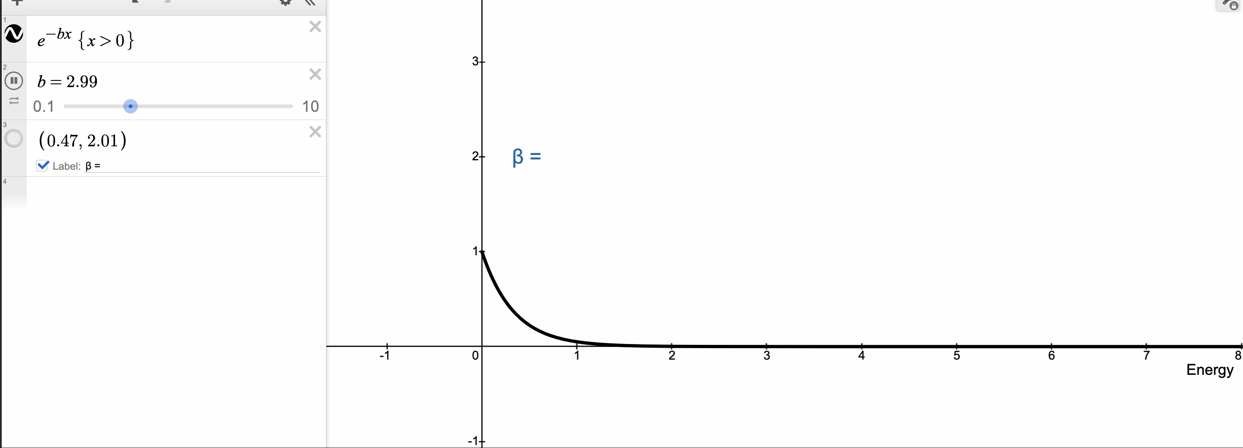
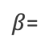
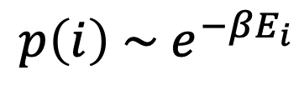
Gibbs State
$$p\left(i\right) \sim e^{−βE_{i}}$$
$β$=

Slide 20
Gibbs State
$$p\left(i\right) \sim e^{−βE_{i}}$$
$β$=
The Gibbs state, at temperature $β^{−1},$ has probability $p(i)$ of being in state $i.$

Slide 21
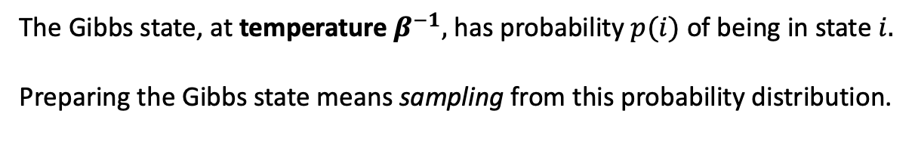
Gibbs State
$$p\left(i\right) \sim e^{−βE_{i}}$$
$β$=
The Gibbs state, at temperature $β^{−1},$ has probability $p(i)$ of being in state $i.$
Preparing the Gibbs state means sampling from this probability distribution.

Slide 22
Why the Gibbs state?

Slide 23
Why the Gibbs state?
Physical Relevance
Gibbs states arise in nature, when a system is in thermal equilibrium.

Slide 24
Why the Gibbs state?
Physical Relevance
Gibbs states arise in nature, when a system is in thermal equilibrium.
At very low temperatures, the Gibbs state will be close to the ground state of the system

Slide 25

Why the Gibbs state?
Physical Relevance
Gibbs states arise in nature, when a system is in thermal equilibrium.
At very low temperatures, the Gibbs state will be close to the ground state of the system
If refrigerators can prepare Gibbs states with quantum mechanics, we can too!

Slide 26
(Classical) Markov Chains
A Markov chain is a stochastic (random) process on a set of states.

Slide 27
(Classical) Markov Chains
A Markov chain is a stochastic (random) process on a set of states.
Start at some state.
1
2
3
4
5

Slide 28
(Classical) Markov Chains
A Markov chain is a stochastic (random) process on a set of states.
Start at some state. Jump to another.
1
2
3
4
5

Slide 29
(Classical) Markov Chains
A Markov chain is a stochastic (random) process on a set of states.
Start at some state. Jump to another. And so forth.
1
2
3
4
5

Slide 30
(Classical) Markov Chains
Key Feature!
A Markov chain is a stochastic (random) process on a set of states.
Start at some state. Jump to another. And so forth.
1
2
3
4
5

Slide 31
(Classical) Markov Chains
Key Feature!
A Markov chain is a stochastic (random) process on a set of states.
Start at some state. Jump to another. And so forth.
Markov Property: The evolution of the system depends only on its
current state
1
2
3
4
5

Slide 32
Quantum Markov Chains
Quantum Markov chains are random quantum processes that still adhere to the Markov property

Slide 33
Quantum Markov Chains
Quantum Markov chains are random quantum processes that still adhere to the Markov property
In 2023, a quantum Markov chain was proposed with the following properties

Slide 34
Quantum Markov Chains
Quantum Markov chains are random quantum processes that still adhere to the Markov property
In 2023, a quantum Markov chain was proposed with the following properties
A quantum computer can simulate the Markov chain

Slide 35
Quantum Markov Chains
Quantum Markov chains are random quantum processes that still adhere to the Markov property
In 2023, a quantum Markov chain was proposed with the following properties
A quantum computer can simulate the Markov chain
After simulating the Markov chain for long enough, the Markov chain converges to a sample of the Gibbs state!

Slide 36
Quantum Markov Chains
Quantum Markov chains are random quantum processes that still adhere to the Markov property
In 2023, a quantum Markov chain was proposed with the following properties
A quantum computer can simulate the Markov chain
After simulating the Markov chain for long enough, the Markov chain converges to a sample of the Gibbs state!
How long? Depends on the system!

Slide 37
Quantum Markov Chains
Quantum Markov chains are random quantum processes that still adhere to the Markov property
In 2023, a quantum Markov chain was proposed with the following properties
A quantum computer can simulate the Markov chain
After simulating the Markov chain for long enough, the Markov chain converges to a sample of the Gibbs state!
How long? Depends on the system!
It is still not known how performant this algorithm is.

Slide 38
My Project
Find the runtime of the quantum Markov chain for a “single-particle” system

Slide 39
My Project
Find the runtime of the quantum Markov chain for a “single-particle” system
A system with just one particle, hopping “quantumly” on a graph

Slide 40
My Project
Find the runtime of the quantum Markov chain for a “single-particle” system
A system with just one particle, hopping “quantumly” on a graph

Slide 41
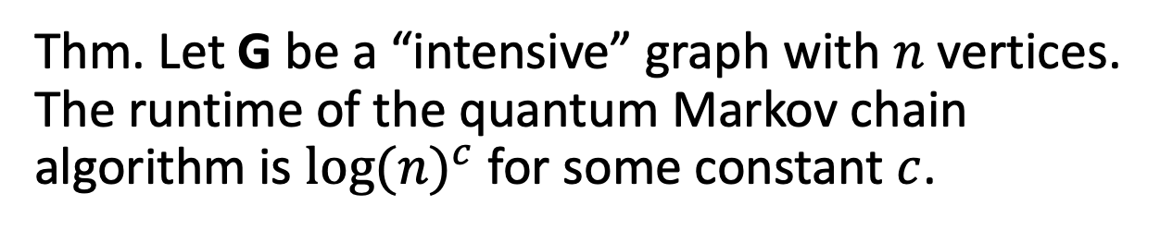
Theorem
Thm. Let G be a “intensive” graph with $n$ vertices. The runtime of the quantum Markov chain algorithm is ${log⁡(n)}^{c}$ for some constant $c$.

Slide 42
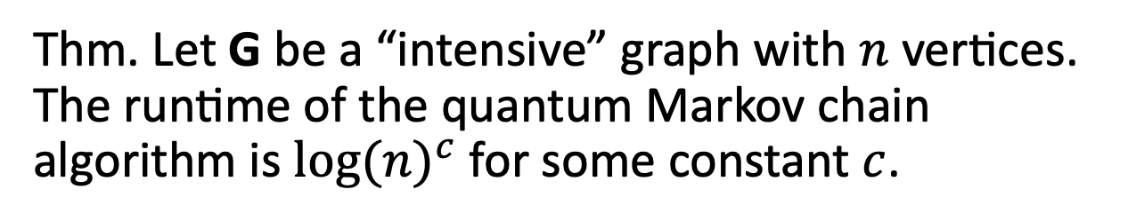
Theorem
Thm. Let G be a “intensive” graph with $n$ vertices. The runtime of the quantum Markov chain algorithm is ${log⁡(n)}^{c}$ for some constant $c$.
What is an Intensive Graph?
Any graph has “energies” like any quantum system
An intensive graph has bounded energies

Slide 43
Theorem
Thm. Let G be a “intensive” graph with $n$ vertices. The runtime of the quantum Markov chain algorithm is ${log⁡(n)}^{c}$ for some constant $c$.
What is an Intensive Graph?
Any graph has “energies” like any quantum system
An intensive graph has bounded energies
Many graphs are intensive!
Graphs with bounded degree

Slide 44
Theorem
Thm. Let G be a “intensive” graph with $n$ vertices. The runtime of the quantum Markov chain algorithm is ${log⁡(n)}^{c}$ for some constant $c$.
What is an Intensive Graph?
Any graph has “energies” like any quantum system
An intensive graph has bounded energies
Many graphs are intensive!
Graphs with bounded degree
Highly separated energies can slow down the algorithm.
Bounded energies avoid this obstacle

Slide 45
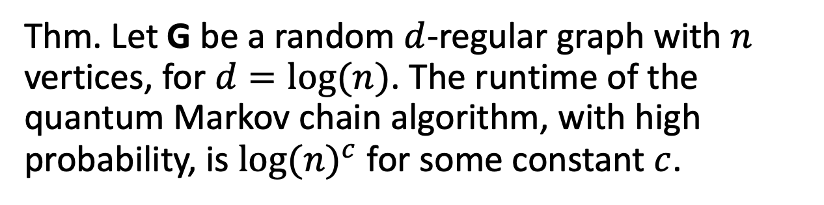
Additional Result
Thm. Let G be a random $d$-regular graph with $n$ vertices, for $d=log⁡(n)$. The runtime of the quantum Markov chain algorithm, with high probability, is ${log⁡(n)}^{c}$ for some constant $c$.

Slide 46
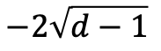
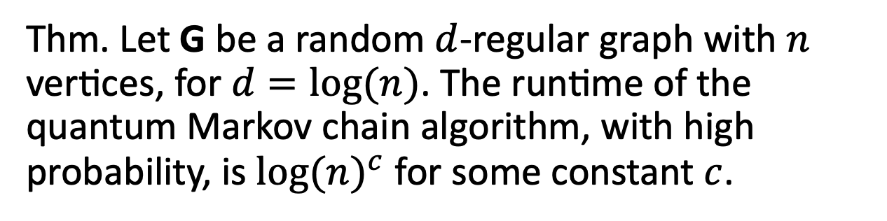
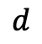
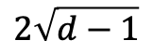
Additional Result
Thm. Let G be a random $d$-regular graph with $n$ vertices, for $d=log⁡(n)$. The runtime of the quantum Markov chain algorithm, with high probability, is ${log⁡(n)}^{c}$ for some constant $c$.
$$−2\sqrt{d−1}$$
$$2\sqrt{d−1}$$
$$d$$

Slide 47
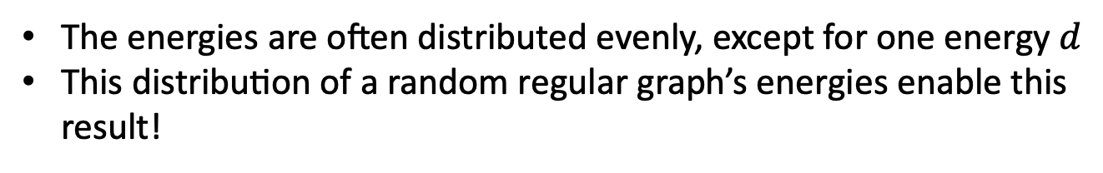
Additional Result
Thm. Let G be a random $d$-regular graph with $n$ vertices, for $d=log⁡(n)$. The runtime of the quantum Markov chain algorithm, with high probability, is ${log⁡(n)}^{c}$ for some constant $c$.
$$−2\sqrt{d−1}$$
$$2\sqrt{d−1}$$
$$d$$
The energies are often distributed evenly, except for one energy $d$
This distribution of a random regular graph’s energies enable this result!

Slide 48
Next Steps

Slide 49
Next Steps
Investigate graphs with special structure

Slide 50
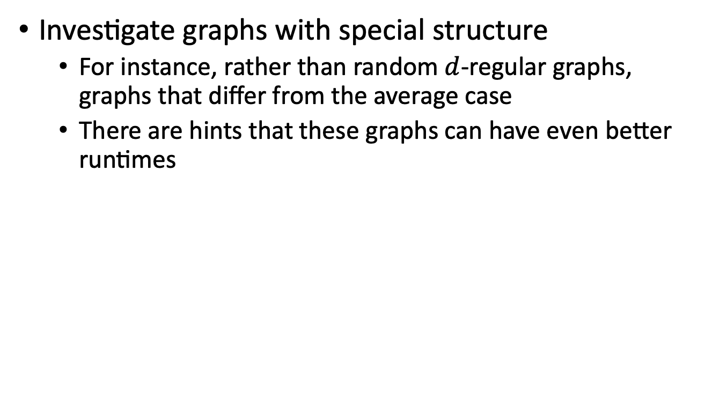
Next Steps
Investigate graphs with special structure
For instance, rather than random $d$-regular graphs, graphs that differ from the average case
There are hints that these graphs can have even better runtimes

Slide 51
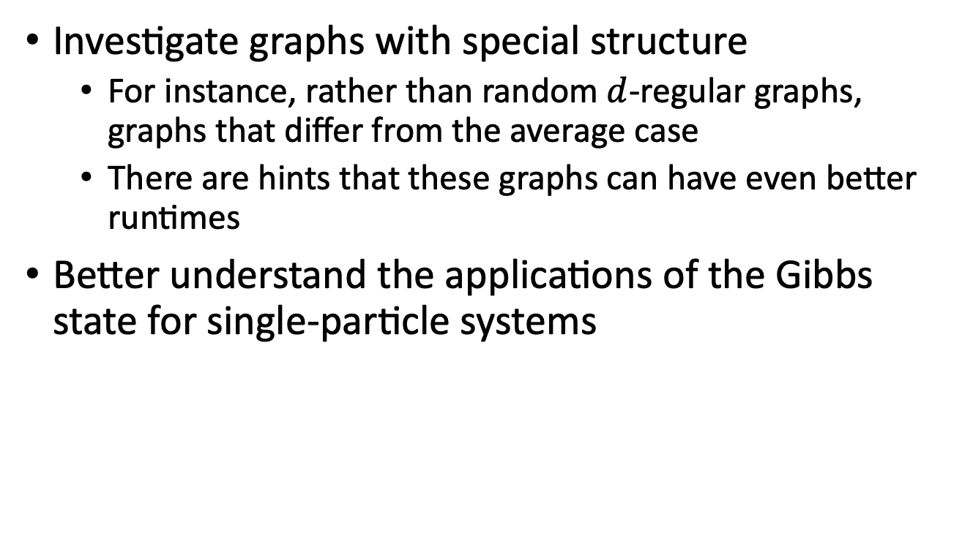
Next Steps
Investigate graphs with special structure
For instance, rather than random $d$-regular graphs, graphs that differ from the average case
There are hints that these graphs can have even better runtimes
Better understand the applications of the Gibbs state for single-particle systems

Slide 52
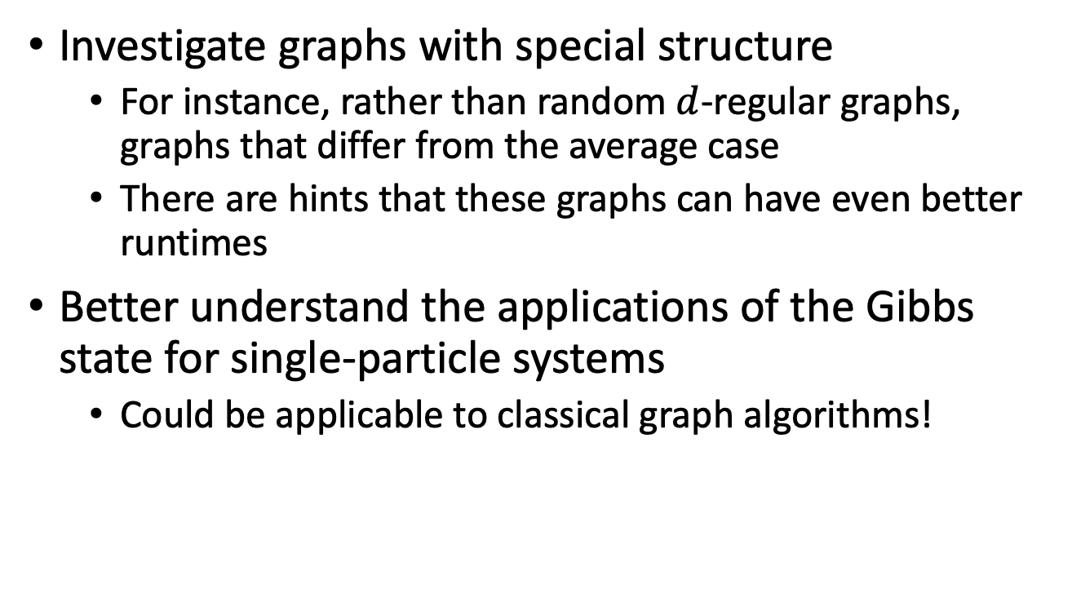
Next Steps
Investigate graphs with special structure
For instance, rather than random $d$-regular graphs, graphs that differ from the average case
There are hints that these graphs can have even better runtimes
Better understand the applications of the Gibbs state for single-particle systems
Could be applicable to classical graph algorithms!

Slide 53
Acknowledgements
My mentors Dr. Mehdi Soleimanifar and Dr. Anthony Chen
Prof. Preskill and the Preskill lab group
Fellow undergraduate researchers
A special thanks to the SURF program and my SURF donors Mr. Zhuang Tang and Ms. Gebing Yi.

Slide 54
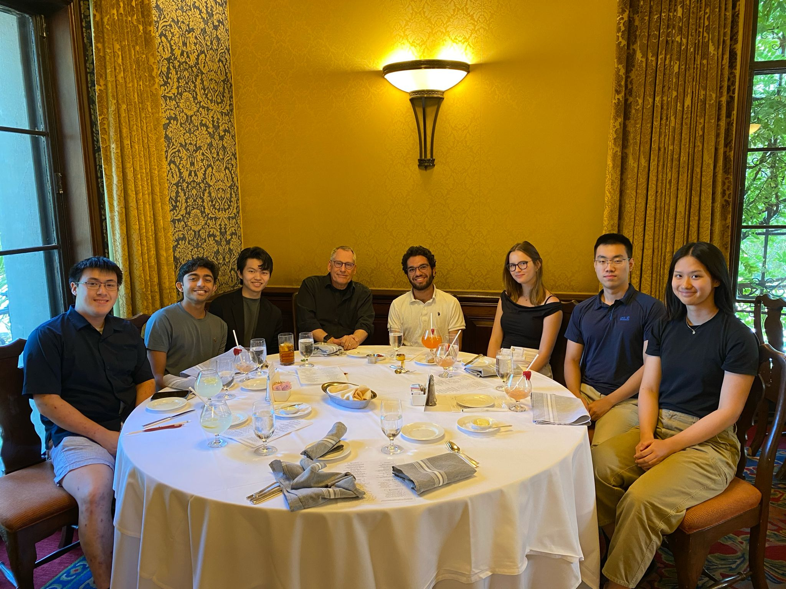
Acknowledgements
My mentors Dr. Mehdi Soleimanifar and Dr. Anthony Chen
Prof. Preskill and the Preskill lab group
Fellow undergraduate researchers
A special thanks to the SURF program and my SURF donors Mr. Zhuang Tang and Ms. Gebing Yi.

